Slide 1

Chapter -04
Systems Analysis
Md. Manirujjaman
1
1/20/2026
Md. Manirujjaman

Slide 2
1
2
3
SYSTEMS PLANNING
THE INITIAL INVESTIGATION
INFORMATION GATHERING
4
5
6
THE TOOLS OF STRUCTURED ANALYSIS
FEASIBILITY STUDY
COST/BENEFIT ANALYSIS
2
1/20/2026
Md. Manirujjaman

Slide 3
SYSTEMS PLANNING
Effective system development must begin with proper MIS planning, supported by management, because planning guides all phases of the system life cycle and is essential for successful system analysis, investigation, and implementation.
3
1/20/2026
Md. Manirujjaman
Notes:
Systems Planning means making a proper plan before developing a system—what system we need, why we need it, what resources are required, and how it will be implemented.
Suppose a university starts developing a new Student Management System without proper planning. Later, they may discover that the fee module required by the Accounts Department or the result requirements of the Exam Office were not considered. The system will then need to be changed again, increasing both time and cost.

Slide 4
SYSTEMS PLANNING
BASES FOR PLANNING IN SYSTEMS ANALYSIS
1
2
3
Information as a Resource:
High Investment in Systems:
Need for Long-Term Planning:
Information is a critical organizational asset, equal in importance to money, facilities, and personnel, and must be carefully planned and managed.
Information systems require significant financial investment, demanding proper planning and management oversight.
Modern systems are complex, integrated, and long-term, requiring formal planning to align them with organizational goals and reduce isolated systems.
4
1/20/2026
Md. Manirujjaman

Slide 5
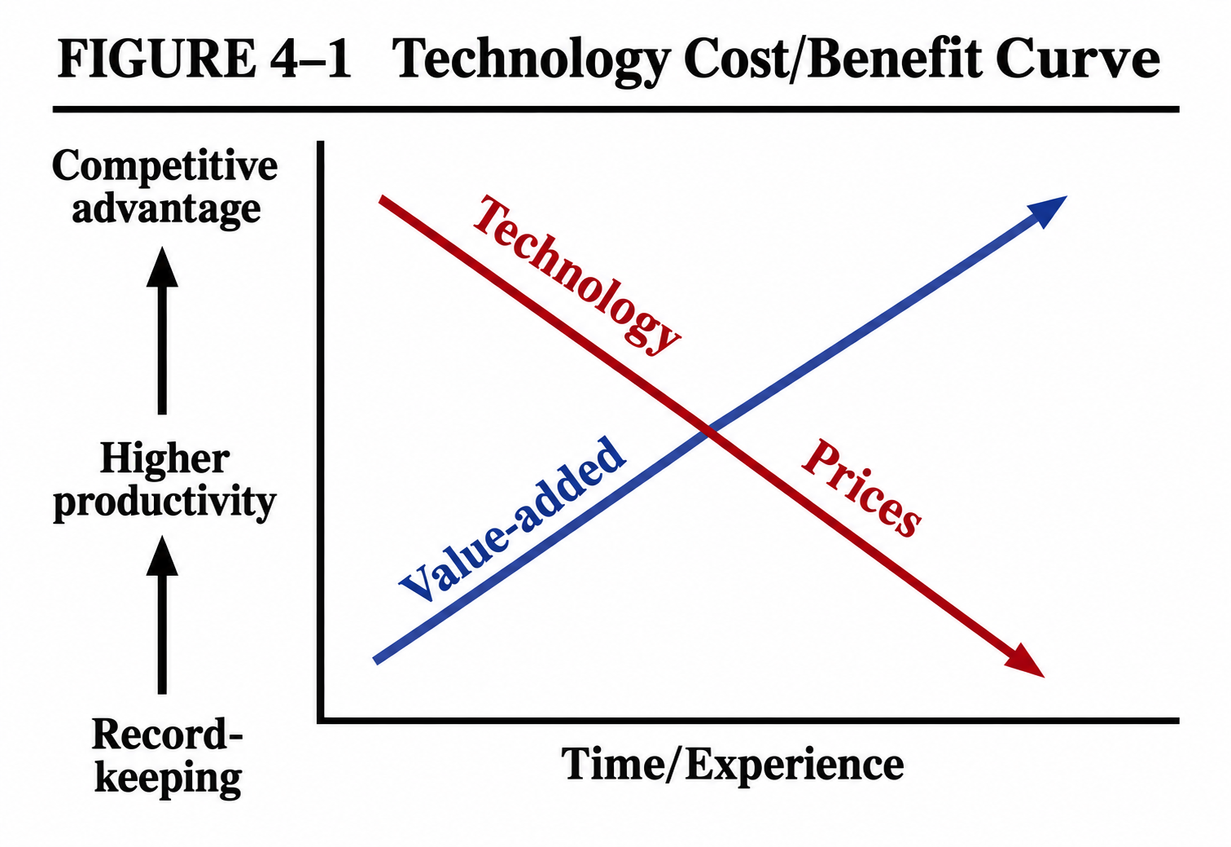
SYSTEMS PLANNING
Business Conditions Influencing Systems Planning
High Interest Rates: Organizations must ensure a strong return on investment (ROI) from information systems.
Inflation Pressure: Rising costs reduce profits, making efficient and well-planned systems essential.
Fixed Employment Costs: Guaranteed employment increases fixed costs, limiting flexibility in expansion.
Resource Shortages: Limited resources restrict growth and require better utilization through systems
Carefully planned and well-used information systems move an organization from basic automation to higher productivity and competitive advantage at lower cost.
5
1/20/2026
Md. Manirujjaman

Slide 6
SYSTEMS PLANNING
Strategic MIS Planning
Planning doesn't happen in a vacuum; it must align with the organization’s overall Master Plan.
Dimension 1: The Time Horizon (How far ahead?)
Dimension 2: The Focus (What is the goal?)
Short-Range: Less than 2 years (The immediate "Yearly Plan").
Medium-Term: 2 to 5 years (Building major modules).
Long-Range: More than 5 years (Conceptual, future-looking).
Strategic: Setting the big-picture objectives and policies.
Managerial: Coordinating resources and middle-management needs.
Operational: The daily "tactical" tasks and technical implementation.
6
1/20/2026
Md. Manirujjaman
Notes:
Planning doesn’t happen in a vacuum”
means:
MIS planning must follow:
Business strategy
Organizational goals
Future direction

Slide 7
SYSTEMS PLANNING
Need of system planning.
Information is a Strategic Asset:
Data is now as valuable as cash or equipment. Planning ensures this "asset" is managed and protected properly.
Resource Management:
IT projects require massive financial investment and specialized personnel. Planning prevents wasting these expensive resources.
System Integration:
Modern systems are complex and share common databases. Planning ensures a new system "talks" to existing ones instead of being isolated.
Organizational Alignment:
Planning ensures the system's goals match the company’s strategic business goals (congruency).
Standardization:
It helps establish uniform hardware and software choices across the company, making maintenance easier and cheaper.
7
1/20/2026
Md. Manirujjaman

Slide 8
THE INITIAL INVESTIGATION
INITIAL INVESTIGATION
System development life cycle begins with Needs Identification, which is simply a User Request to fix or improve a system. Since companies get many requests, they use an Initial Investigation to "filter" them. The goal is to decide if a request is Valid and Feasible before spending money.
The Three Results:
Do Nothing:
Modify System:
Build New System:
The problem isn't worth the cost.
A quick fix to the current software.
A complete replacement is needed
8
1/20/2026
Md. Manirujjaman

Slide 9
THE INITIAL INVESTIGATION
A User Request Form is the official document that identifies a need for change and authorizes an Initial Investigation. It typically includes these 9 key items:
Project Title: A simple name for the requested work.
Problem Definition: A description of the current issue (Nature of work).
Submission Date: When the request was filed.
Deadline: When the user expects the job to be finished.
Objectives: The specific purpose or goals of the request.
Expected Benefits: What the organization gains (e.g., cost savings, better speed).
Input/Output Details: The volume (pages/copies) and frequency (daily/weekly) of data.
Requester Info: Signature and contact details of the person asking for the change.
Approval Info: Signature and contact details of the manager authorizing the request.
9
1/20/2026
Md. Manirujjaman

Slide 10
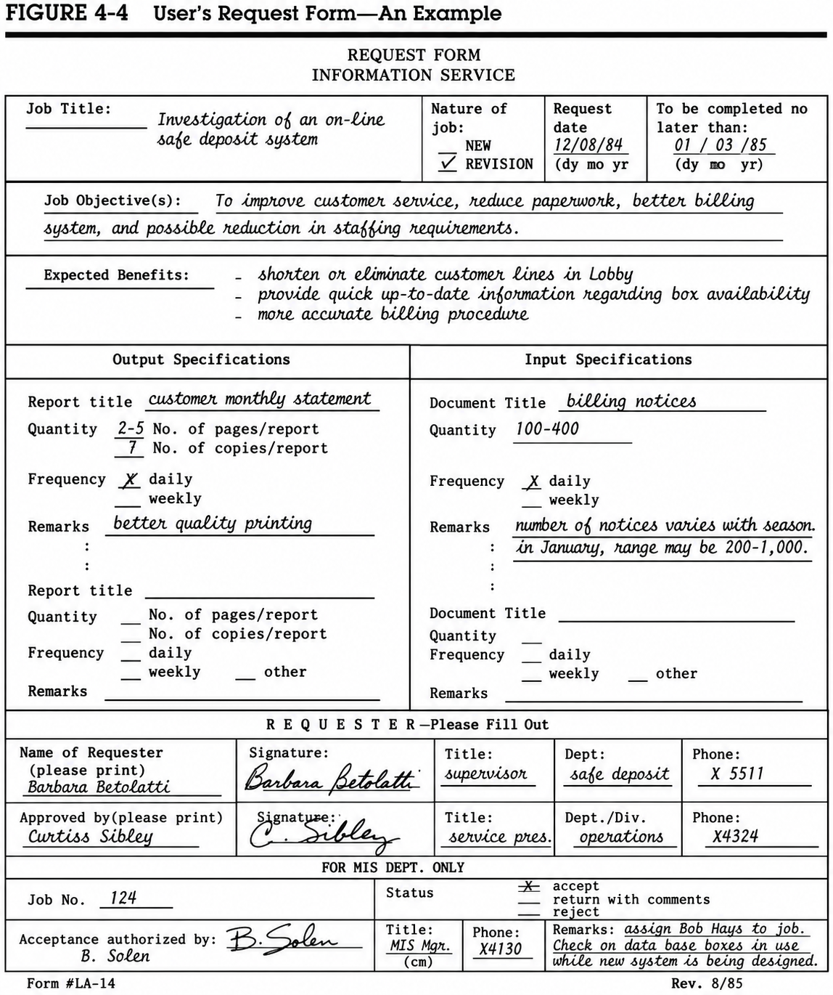
THE INITIAL INVESTIGATION
10
1/20/2026
Md. Manirujjaman

Slide 11
NEEDS IDENTIFICATION
Needs Identification: Defining the Real Problem
1
2
3
Core Goal:
Needs vs. Wants:
Problem vs. Symptoms:
The success of a system depends on accurately defining and investigating a problem before jumping to a solution.
The analyst focuses on what the user needs to function effectively, rather than just what they want (which may be unnecessary or incorrect).
This step helps the analyst find the real problem rather than just reacting to symptoms (the visible signs of the problem).
11
1/20/2026
Md. Manirujjaman
Notes:
Core Goal:
Customer service in a bank is very slow. Management says, “We need new software.”
But after investigation, the analyst finds that the software is not the real problem; there are four unnecessary manual approval steps.
2. Needs vs. Wants:
A hospital is developing a new patient management system.
A doctor says,
“I want animations and many colors on the dashboard.”
That is a want.
But the doctor’s actual needs are:
quickly viewing patient history,
checking allergy information,
viewing current medications.
Problem vs. Symptoms:
Customers of an e-commerce company complain:
“Orders are being delivered late.”
This is a symptom.
After investigation, the analyst finds that:
warehouse stock information is not updated properly,
the system shows products as available even when they are out of stock,
additional procurement is required, causing delays.
So, the real problem is inaccurate inventory information, while late delivery is only the symptom.

Slide 12
INFORMATION REQUIREMENTS
Why Determining Requirements is Difficult
1
2
3
Constant Change:
Articulation Issues:
Lack of Immediate Motivation:
System and user requirements are dynamic; they must be frequently modified to stay relevant.
Unless a user is highly experienced, it is difficult for them to describe complex functions and processes clearly.
Users often lose interest because the "reward" (the working system) isn't seen until the final implementation phase.
Users think in qualitative terms (generalities and flexibility).
12
1/20/2026
Md. Manirujjaman

Slide 13
INFORMATION REQUIREMENTS
The Three Main Strategies - for determining information requirements:
The Three Main Strategies
1
2
3
Asking:
Existing Systems:
Prototyping:
The analyst simply asks users what they need. This works best for stable systems where users know exactly what they want.
The analyst looks at current reports and data to see what is already there and what is missing.
A small version of the system is built first. Users try it out and then suggest changes based on their experience.
13
1/20/2026
Md. Manirujjaman

Slide 14
INFORMATION REQUIREMENTS
Factors for Choosing a Strategy
The best method depends on the Level of Uncertainty:
Low Uncertainty (Use "Asking"):
High Uncertainty (Use "Prototyping"):
Choose this when the requirements are stable and the user can easily explain them.
Choose this when it is hard to visualize the system or when needs are constantly changing.
14
1/20/2026
Md. Manirujjaman
Notes:
Low Uncertainty: requirements are clear and stable. Example
High Uncertainty: unclear, changing, or hard to imagine.
within one university system, some parts have low uncertainty and some have high uncertainty.
Low uncertainty → rules are fixed, already known, and rarely change,
Example: Result Processing System, Salary and Payroll System, Student Fee Payment System, Student Registration System
High uncertainty → human behavior, teaching style, or experience matters, and requirements are hard to define clearly
.
Example-Lecture Management, Faculty Performance Evaluation System(teaching quality is subjective).
Is a Syllabus Management System Low or High Uncertainty?

Slide 15
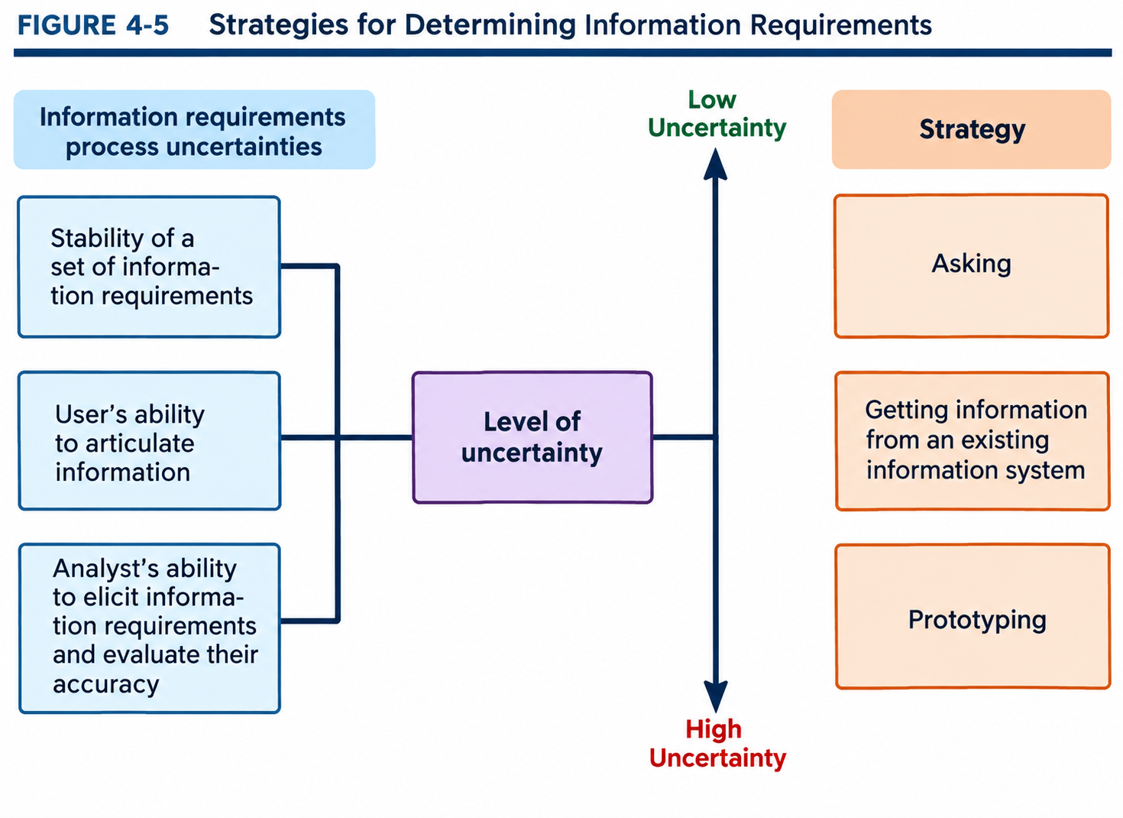
INFORMATION REQUIREMENTS
15
1/20/2026
Md. Manirujjaman

Slide 16
INFORMATION REQUIREMENTS
User Defensive Strategies (The "Predicament")
When users struggle to meet an analyst's technical expectations, they often adopt these strategies:
1
2
3
The Kitchen Sink:
The Smoking Screen:
The Same Thing:
Requesting every possible report and feature out of fear of missing something (usually indicates inexperience).
Requesting many features to use as "bargaining chips," knowing they only need one or two (indicates a savvy but cautious user).
Asking for the exact current manual process but on a computer (indicates laziness or a lack of knowledge).
16
1/20/2026
Md. Manirujjaman
Notes:
When users cannot clearly explain their needs to a system analyst, they try to
protect themselves
.
This protection is called
user defensive strategies.
In the Kitchen Sink strategy, the user thinks: “What if something important is left out?” So the user asks for every possible feature and report, even if many of them may not be necessary.
Imagine a family going on a picnic. One person packs food, chairs, a fan, pillows, an extra table, a cooker, and a bucket—as if they are going to take the kitchen sink too!
“What if I do not request a feature now and need it later?”
So the user asks for attendance reports, salary reports, yearly reports, weekly reports, employee history, graphs, comparisons, and many other features.
A smoke screen means creating smoke to hide the real thing.
For example, in a battlefield, smoke may be used so the other side cannot clearly see the actual movement. Many things appear in front, while the real intention remains hidden.
The same idea can happen in Systems Analysis.
Suppose a manager actually needs only two features:
Automated approval
Monthly performance report
But the manager gives the analyst a list of ten features:
dashboard
mobile app
SMS
email alert
graph
export
biometric integration
automated approval
monthly report
analytics
Then the analyst says, “All of these features are not possible within the budget.”
The manager replies:
“Okay, remove the mobile app, SMS, and graph. But automated approval and the monthly report must remain.”
.

Slide 17
INFORMATION REQUIREMENTS
Human Limitations (Psychological Barriers)
Short-term Memory:
Recency Effect:
Users only remember a few "important" things during an interview.
Users give more weight to recent problems than those from the past.
Availability Bias:
Bounded Rationality:
Users only ask for features based on the information they can see right now.
Humans simplify complex problems because our brains have limited processing capacity.
17
1/20/2026
Md. Manirujjaman

Slide 18
INFORMATION GATHERING
Three Ways to "Ask"
1
2
3
Questions:
Brainstorming:
Group Consensus:
Using open-ended questions for opinions or closed questions for facts.
A group meeting to generate new or non-traditional ideas.
Using a "Delphi" method where people answer questionnaires until everyone agrees, avoiding pressure from bosses.
18
1/20/2026
Md. Manirujjaman

Slide 19
INFORMATION GATHERING
The Goal of the Information Analyst
The Mission: To determine what the user needs (essential for the job) rather than what they want (nice to have).
The Process:
1. Ask what is currently available.
2. Identify what is missing.
3. Reach an agreement on what the new system will provide.
The Outcome: A "Logical Design" that serves as the foundation for the "Physical Design."
19
1/20/2026
Md. Manirujjaman

Slide 20
INFORMATION GATHERING
Fact Finding Tools :
Review of Written Documents:
On-site Observations:
This involves examining official manuals, forms, and reports to understand how the system is designed to work.
The analyst watches the work process in person to see how tasks are actually performed in the real-world environment.
Interviews:
Questionnaires:
Direct conversations with users and staff to gather their specific requirements, opinions, and feelings about the system.
A tool used to collect information from a large group of people efficiently
20
1/20/2026
Md. Manirujjaman

Slide 21
STRUCTURED ANALYSIS
the tools of structured analysis
Review of Written Documents:
Examining existing manuals, forms, and reports to understand how the system is currently designed to work.
On-site Observations:
Watching the physical processes and person-to-person interactions to see how work is actually handled in the environment.
Interviews:
Direct communication with users to gather specific requirements, feelings, and opinions.
Questionnaires:
Distributing forms to collect data from a large group of people efficiently.
Organization Charts:
Preparing a visual chart that lists functions and the people who perform them to understand the work environment and reporting structure.
21
1/20/2026
Md. Manirujjaman

Slide 22
FEASIBILITY STUDY
Feasibility study:
Technical Feasibility
Checks whether the required hardware, software, and technology are available and usable.
Economic Feasibility
Examines whether the benefits of the system are greater than its costs.
Operational Feasibility
Determines whether the system will work in the organization and be accepted by users.
Schedule (Time) Feasibility
Evaluates whether the system can be completed within the required time frame.
Legal Feasibility
Ensures the system does not violate laws, regulations, or company policies.
22
1/20/2026
Md. Manirujjaman

Slide 23
COST/BENEFIT ANALYSIS
COST/BENEFIT ANALYSIS
Costs
Development Costs –
Operating Costs –
Fixed Costs –
Cost of designing and building the system.
Day-to-day running costs of the system.
Costs that do not change with system usage.
Variable Costs –
Direct Costs –
Indirect Costs –
Costs that change based on system usage.
Costs directly related to the system.
Costs not directly tied to the system but affected by it.
23
1/20/2026
Md. Manirujjaman

Slide 24
COST/BENEFIT ANALYSIS
COST/BENEFIT ANALYSIS
Benefits
Evaluation Measures
Tangible Benefits – Benefits that can be measured in money.
Intangible Benefits – Benefits that cannot be easily measured in money.
Direct Benefits – Benefits that result directly from the system.
Indirect Benefits – Secondary or long-term benefits of the system.
Payback Period – Time needed to recover the investment.
Return on Investment (ROI) – Profit gained from the system compared to its cost.
Net Present Value (NPV) – Value of future benefits compared to current costs.
24
1/20/2026
Md. Manirujjaman

Slide 25
Thank You
25
1/20/2026
Md. Manirujjaman

